Slide 1
KIET Groups of institutions, Ghaziabad
Project on
Traffic Sign Recognition System
Supervisor
Mr. Pawan Kumar Pal
Presented by
Prashant Gupta
Asish Kumar
Anubhav Kumar

Slide 2
ABSTRACT
Traffic Sign Recognition (TSR) is an important part of the driver support functions needed to make
intelligent vehicles. The automatic system for classification of traffic signs is a critical task of an
Advanced Driver Assistance Systems (ADAS) and a fundamental technique utilized as integral part
to the various vehicles. The recognizable features of a traffic image are utilized for their
classification. Traffic signs are designed in such a way that they contain specific shapes and colors,
with some text and some symbols with high contrast to the background. In this project, we
proposed hybrid approach for classification of traffic signs by SIFT for image feature extraction and
SVM for classification. The proposed work is divided into different phases like Feature Extraction
and Classification Phase. MATLAB is used for the implementation purpose of proposed framework
and classification is carried out by utilizing real traffic sign images.

Slide 3
INTRODUCTION
TRAFFIC SIGNS
TRAFFIC SIGN OR ROAD SIGNS ARE SIGNS ERECTED AT THE SIDE OF OR ABOVE ROADS TO GIVE INSTRUCTIONS OR PROVIDE INFORMATION TO ROAD USERS.
These signs are used to make sure that free movement of traffic isn’t hampered, while the road users are made aware of the specific laws, such as those of speed limits and no parking zones.

Slide 4
Traffic Sign Recognition
Traffic-sign recognition is a technology by which a vehicle is able to recognize the traffic signs put on
the road e.g. "speed limit" or "turn ahead".
The first TSR systems which recognized speed limits were developed in cooperation by Mobileye
and Continental .
In 2008 designed BMW 7 Series, and the Mercedes-Benz’s.
Traffic Sign Recognition(TRS):
Detection
Classification

Slide 5
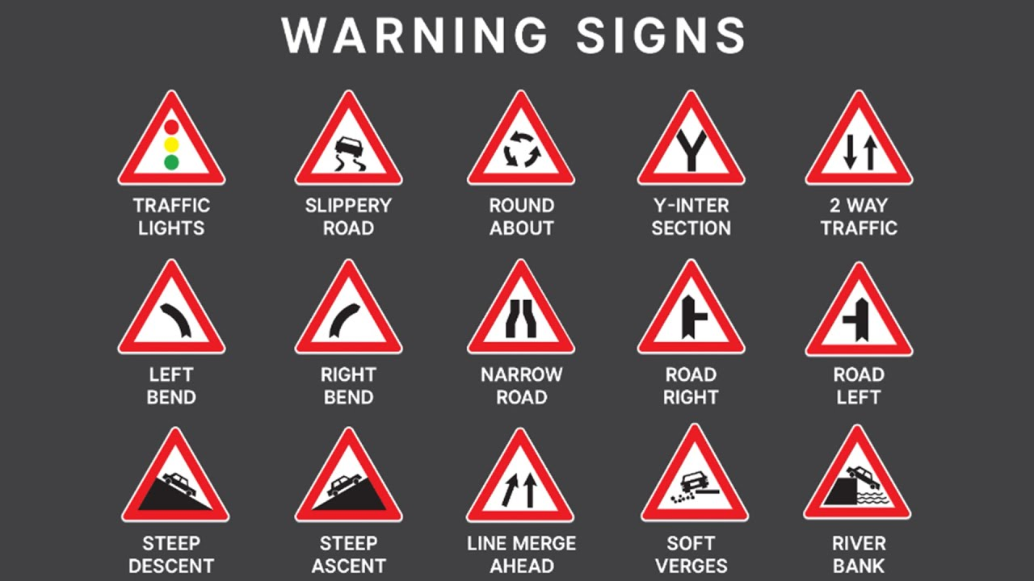
THESE ARE SOME TRAFFIC SIGNS:
WARNING SIGNS:
Warnings signs are used to warn of hazards.

Slide 6
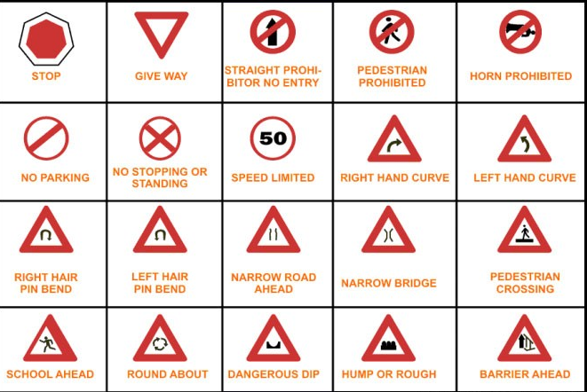
MANDATORY SIGNS:
These signs indicate what must one do, rather than must not do.

Slide 7
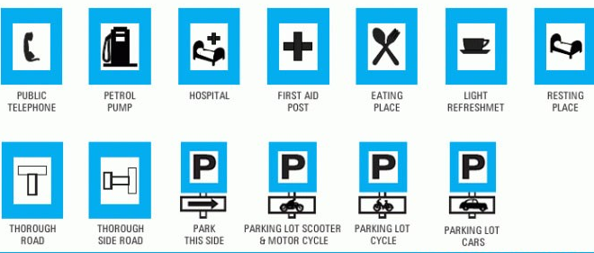
INFORMATORY SIGNS:
These are a type of traffic that are used to tell the road users about information such as that on the destination, distances, fuel stations, nearby medical centre, public convenience, etc.

Slide 8
ALGORITHM
Convolutional neural network (CNN) :
A convolutional neural network, or CNN, is a deep learning neural network sketched for processing structured arrays of data such as portrayals.
CNN are very satisfactory at picking up on design in the input image, such as lines, gradients, circles, or even eyes and faces. This characteristic that makes convolutional neural network so robust for computer vision.
CNN can run directly on a underdone image and do not need any preprocessing. A convolutional neural network is a feed forward neural network, seldom with up to 20.The strength of a convolutional neural network comes from a particular kind of layer called the convolutional layer.
CNN contains many convolutional layers assembled on top of each other, each one competent of recognizing more sophisticated shapes.

Slide 9
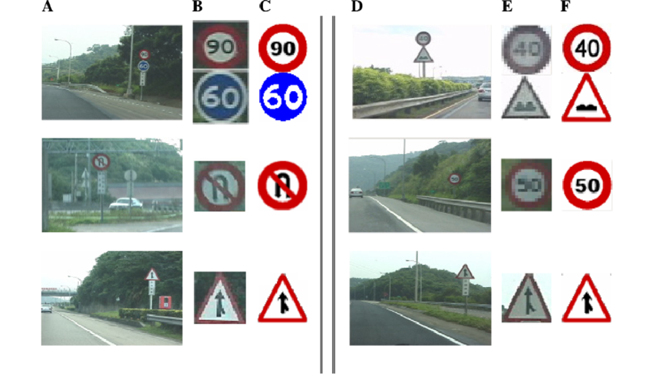
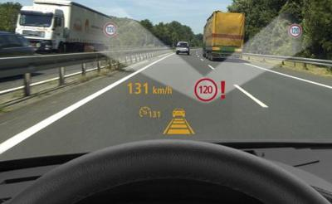
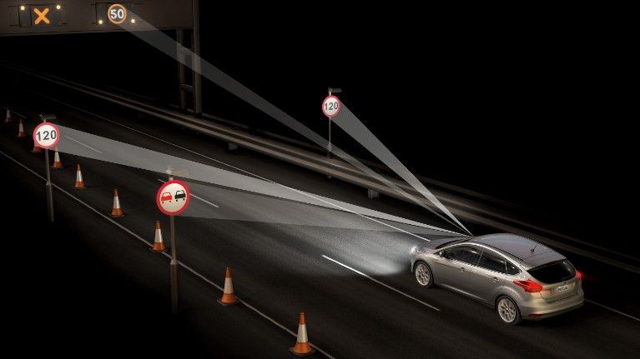
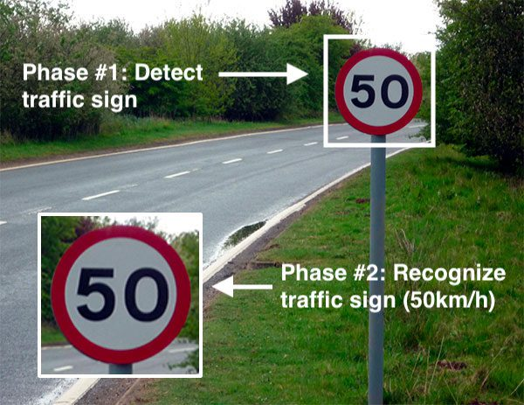
SOME EXPERIMENTAL RESULTS

Slide 10
LITERATURE REVIEW
Road-Sign Detection and Recognition Based on Support Vector Machines
This paper presents an automatic road-sign detection and recognition system based on support vector machines (SVMs). In automatic traffic-sign maintenance and in a visual driver-assistance system, road-sign detection and recognition are two of the most important functions. This system is able to detect and recognize circular, rectangular, triangular, and octagonal signs.
The proposed recognition system is based on the generalization properties of SVMs. The system consists of three stages: 1) segmentation according to the color of the pixel; 2) traffic-sign detection by shape classification using linear SVMs; and 3) content recognition based on Gaussian-kernel SVMs.

Slide 11
ADAS and Video Surveillance Analytics System Using Deep
Learning Algorithms on FPGA
Deep learning algorithms, such as CNN (Convolutional Neural Network), can provide high accuracy for great number of applications including ADAS (Advanced Driver Assistance System) and video surveillance analytics. Considering processing speed and energy efficiency, FPGA (Field Programmable Gate Arrays) is a good hardware to construct customized CNN solution.
ADAS (Advanced Driver Assistance System) technology is used for advancement in the field of surveillance and for traffic as well as symbol recognition systems. This is mainly used in the cars and other smart devices for detection of symbols and act according to it. Consider a ‘breaker’ symbol on the road sides after recognizing that symbol the car will automatically slow and similar cases can be observed for various symbols.

Slide 12
CONCLUSION
The algorithm that has been used for traffic signs it can be generalized to deal with other kinds of objects. The known difficulties that exist for object recognition in outdoor environment have been considered. This way the system is immune to lighting changes, occlusions and object deformation being useful for driver support systems.
Due to this knowledge of the sign status, it is believed that the system is useful for other applications such as maintenance and inventories of traffic sign in highway and cities.

Slide 13
REFERENCES
[1] A. Nikonorov, P. Yakimov, M. Petrov, Traffic sign detection on GPU using color shape regular expressions, VISIGRAPP IMTA-4, Paper 8 (2013).
[2] R. Belaroussi, P. Foucher, J.P. Tarel, B. Soheilian, P. Charbonnier, N. Paparoditis, Road Sign Detection in Images, A Case Study, 20th International Conference on Pattern Recognition (ICPR), 2010, pp. 484-488
[3] Aditya, A.M., & Moharir, S. (2016). Study of Traffic Sign Detection and Recognition Algorithms.
[4] Mogelmose, M. M. Trivedi and T. B. Moeslund, "Vision-based traffic sign detection and analysis for intelligent driver assistance systems: Perspectives and survey", IEEE Trans. Intell. Transp. Syst., vol. 13, pp. 1484-1497, Dec. 2012.
[5] P. Viola and M. J. Jones, "Robust real-time face detection", Int. J. Comput. Vis., vol. 57, no. 2, pp. 137-154, 2004.
[6] L. Fletcher, N. Apostoloff, L. Petersson and A. Zelinsky, "Vision in and out of vehicles", IEEE Intell. Syst., vol. 18, no. 3, pp. 12-17, May/Jun. 2003
[7] S. Lafuente-Arroyo, P. Gil-Jimnez, R. Maldonado-Bascn, F. Lpez-Ferreras and S. Maldonado-Bascn, "Traffic sign shape classification evaluation I: SVM using distance to borders", Proc. IEEE Intell. Veh. Symp., pp. 557-562, 2005-Jun.
[8] V. Balali, A. A. Rad and M. Golparvar-Fard, "Detection classification and mapping of U.S. traffic signs using Google street view images for roadway inventory management", Vis. Eng., vol. 3, no. 1, pp. 15, 2015.
[9] K. C. P. Wang, Z. Hou and W. Gong, "Automated road sign inventory system based on stereo vision and tracking", Comput.-Aided Civil Infrastruct. Eng., vol. 25, no. 6, pp. 468-477, 2010.

